Slide 1



JUSTDRINK SALES ANALYSIS STUDY GROUP 4
View in Power BI
Last data refresh:
11/12/2025 4:14:07 PM UTC
Downloaded at:
11/12/2025 4:22:06 PM UTC

Slide 2
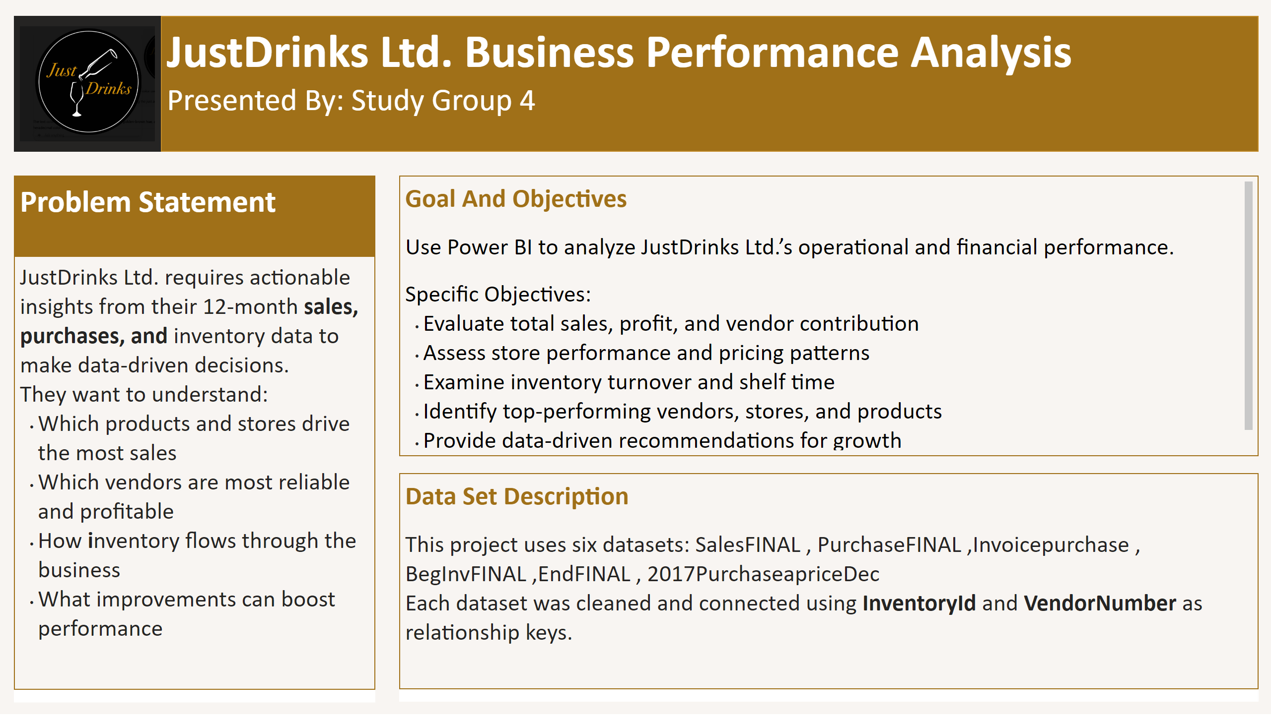
PROJECT INTRODUCTION
Notes:
textbox
No alt text provided
shape
No alt text provided
textbox
No alt text provided
shape
No alt text provided
textbox
No alt text provided
image
No alt text provided
textbox
No alt text provided
shape
No alt text provided
textbox
No alt text provided
shape
No alt text provided
shape
No alt text provided

Slide 3
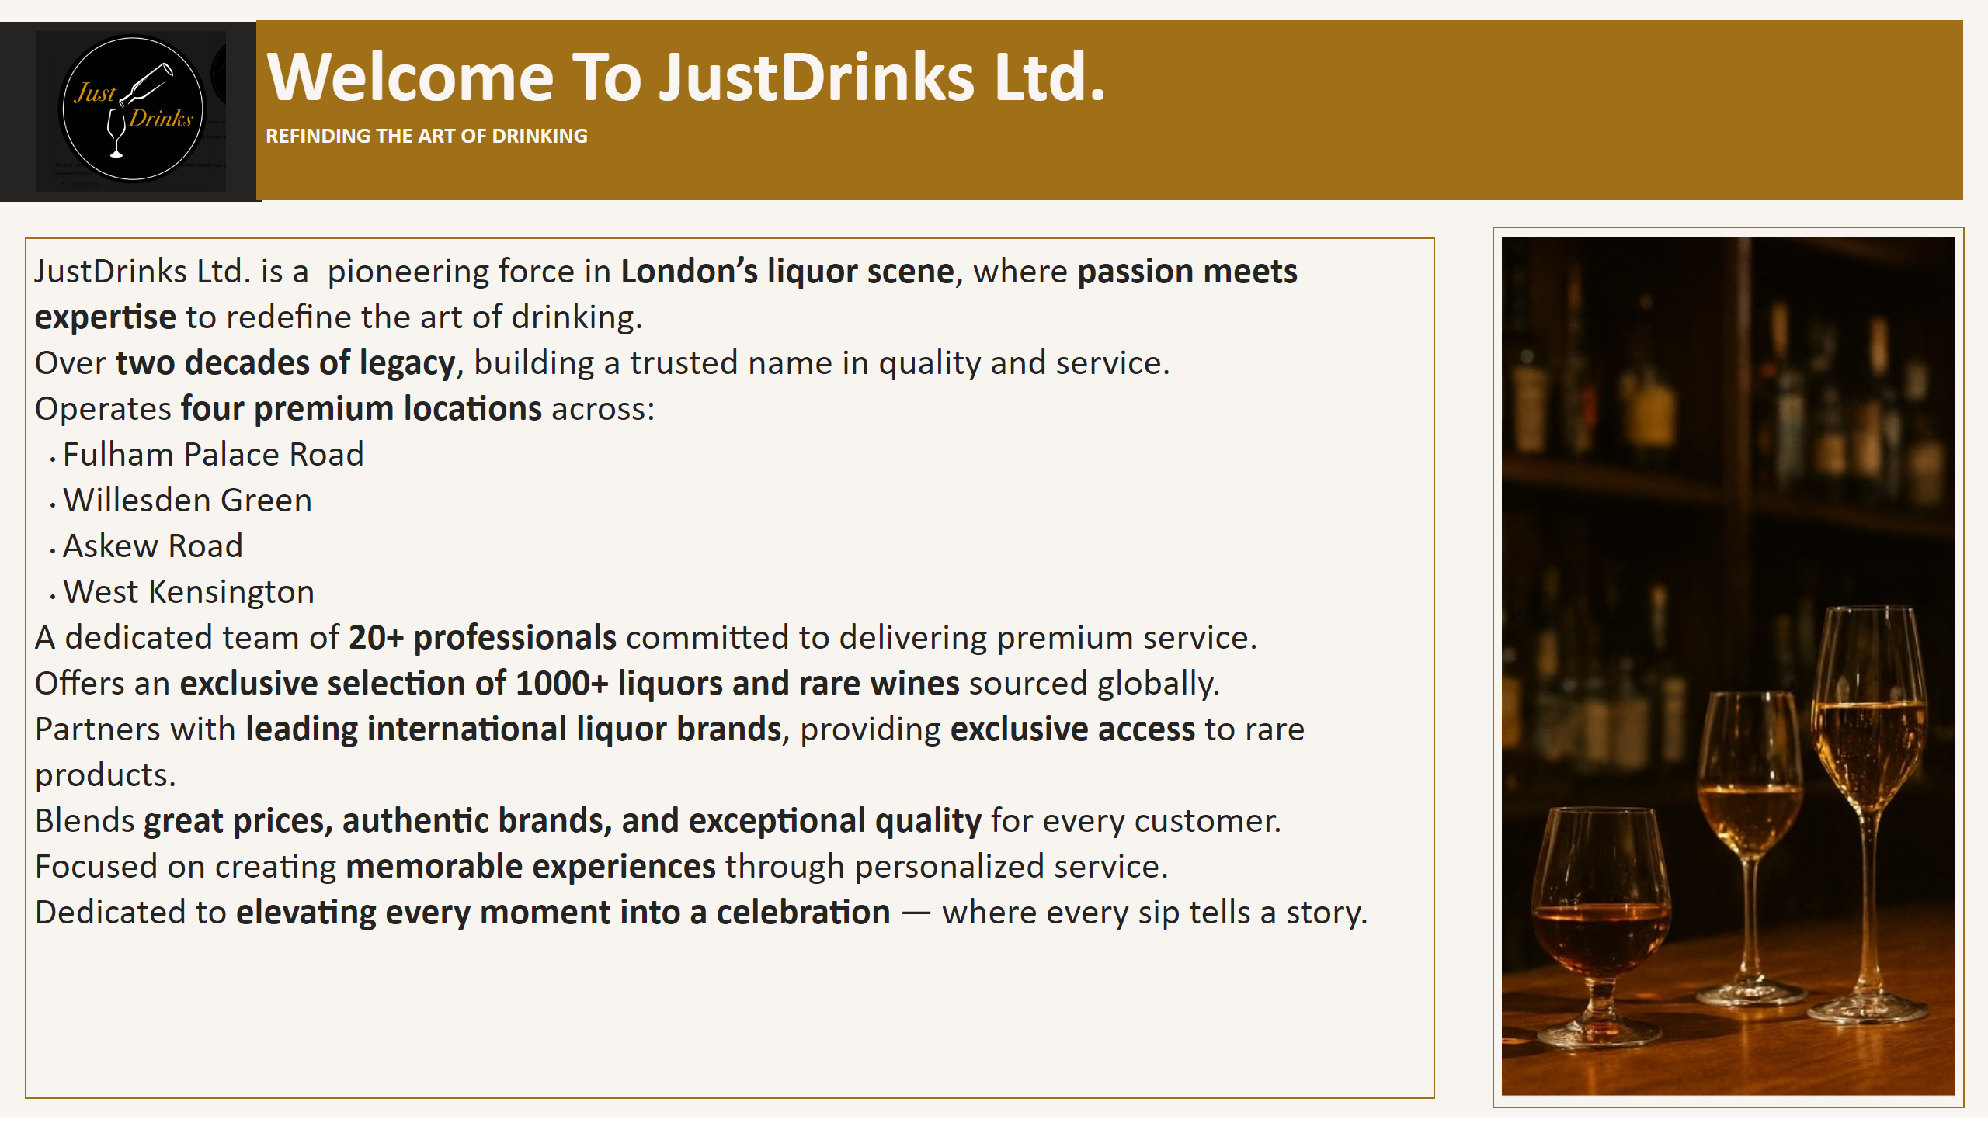
ABOUT JustDrinks
Notes:
image
No alt text provided
textbox
No alt text provided
image
No alt text provided
shape
No alt text provided
textbox
No alt text provided

Slide 4
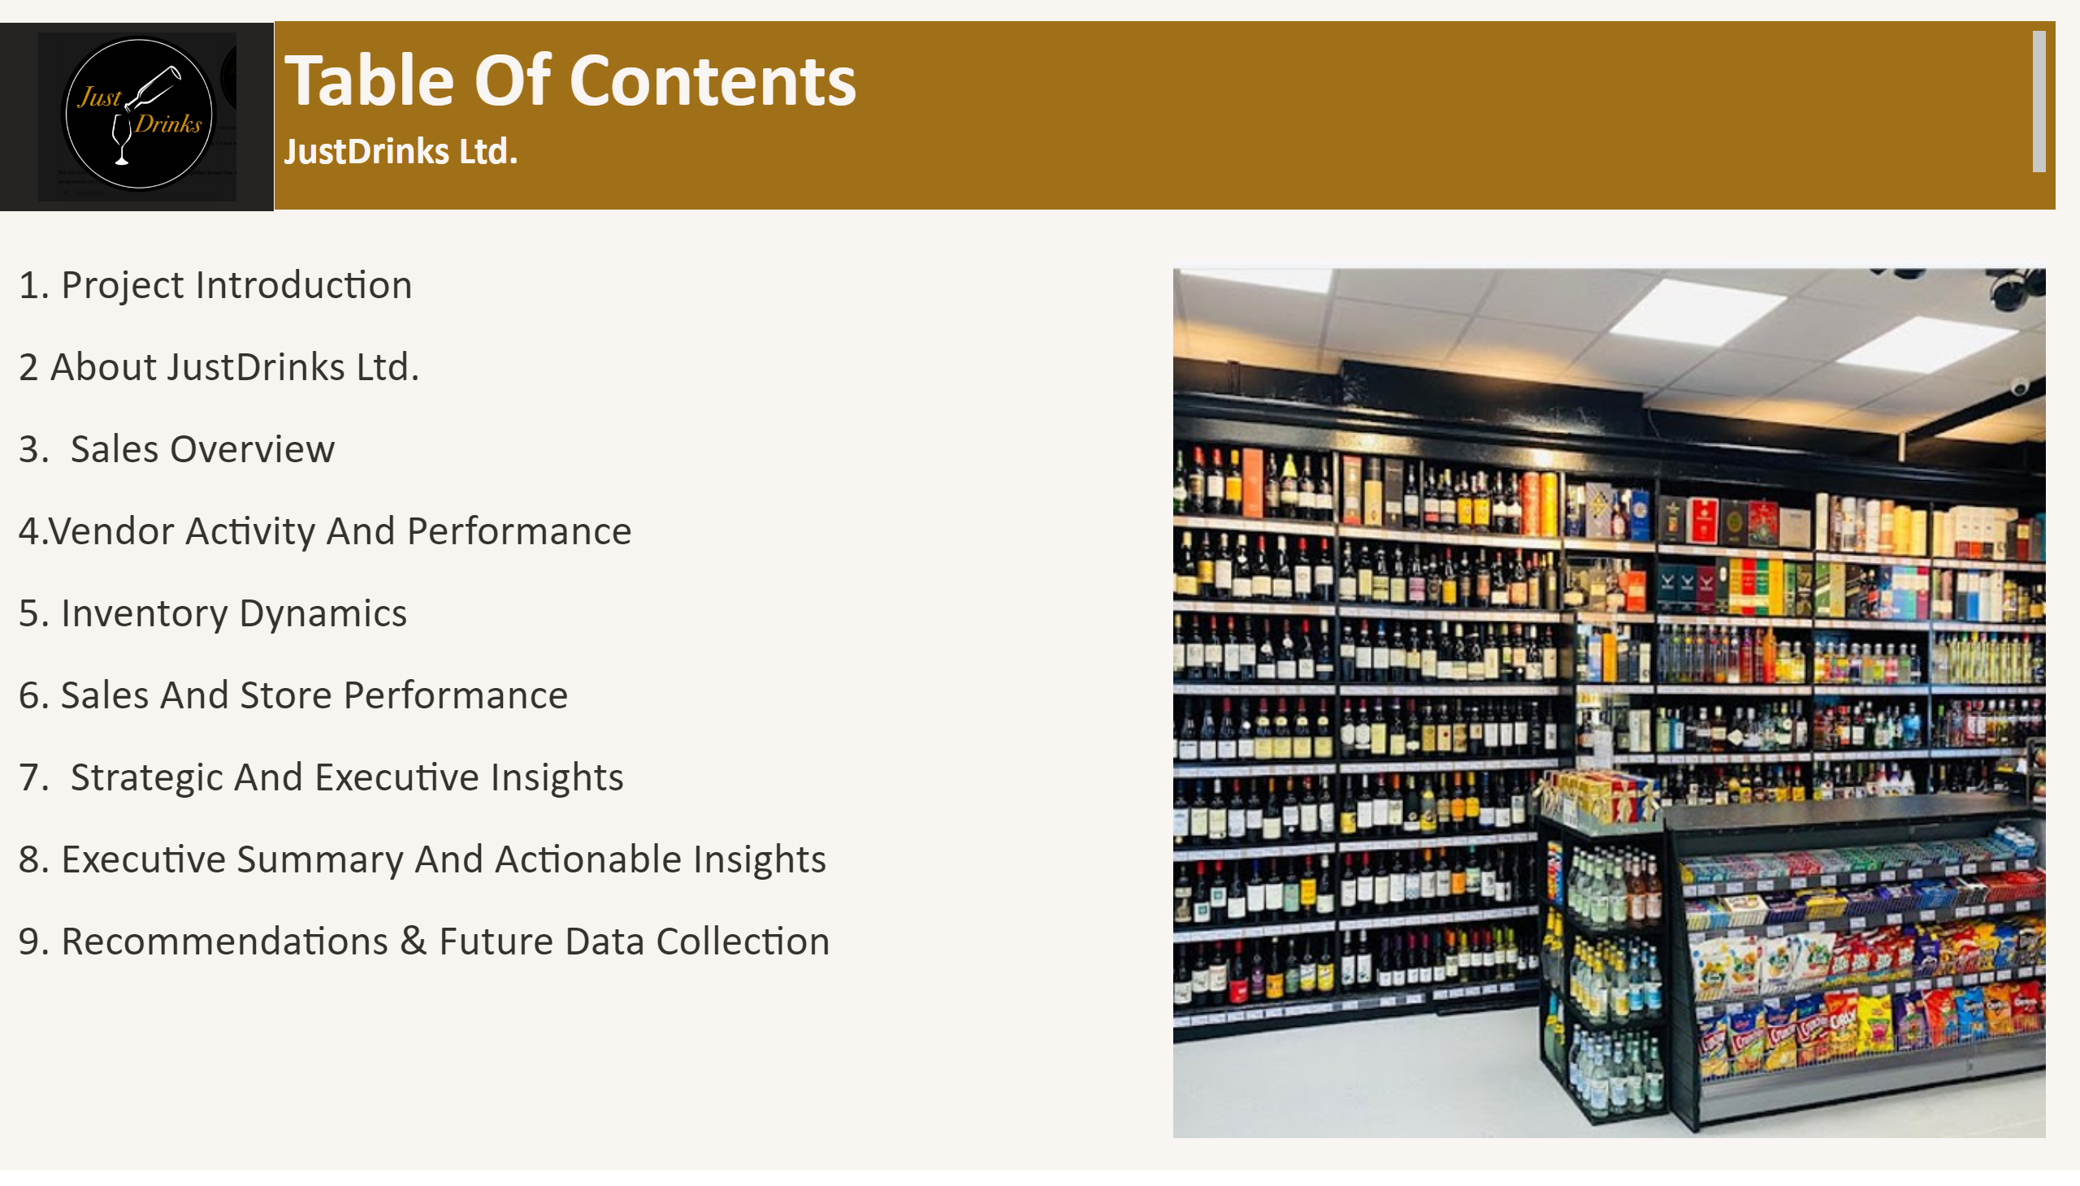
TABLE OF CONTENTS
Notes:
shape
No alt text provided
image
No alt text provided
image
No alt text provided
textbox
No alt text provided
textbox
No alt text provided

Slide 5
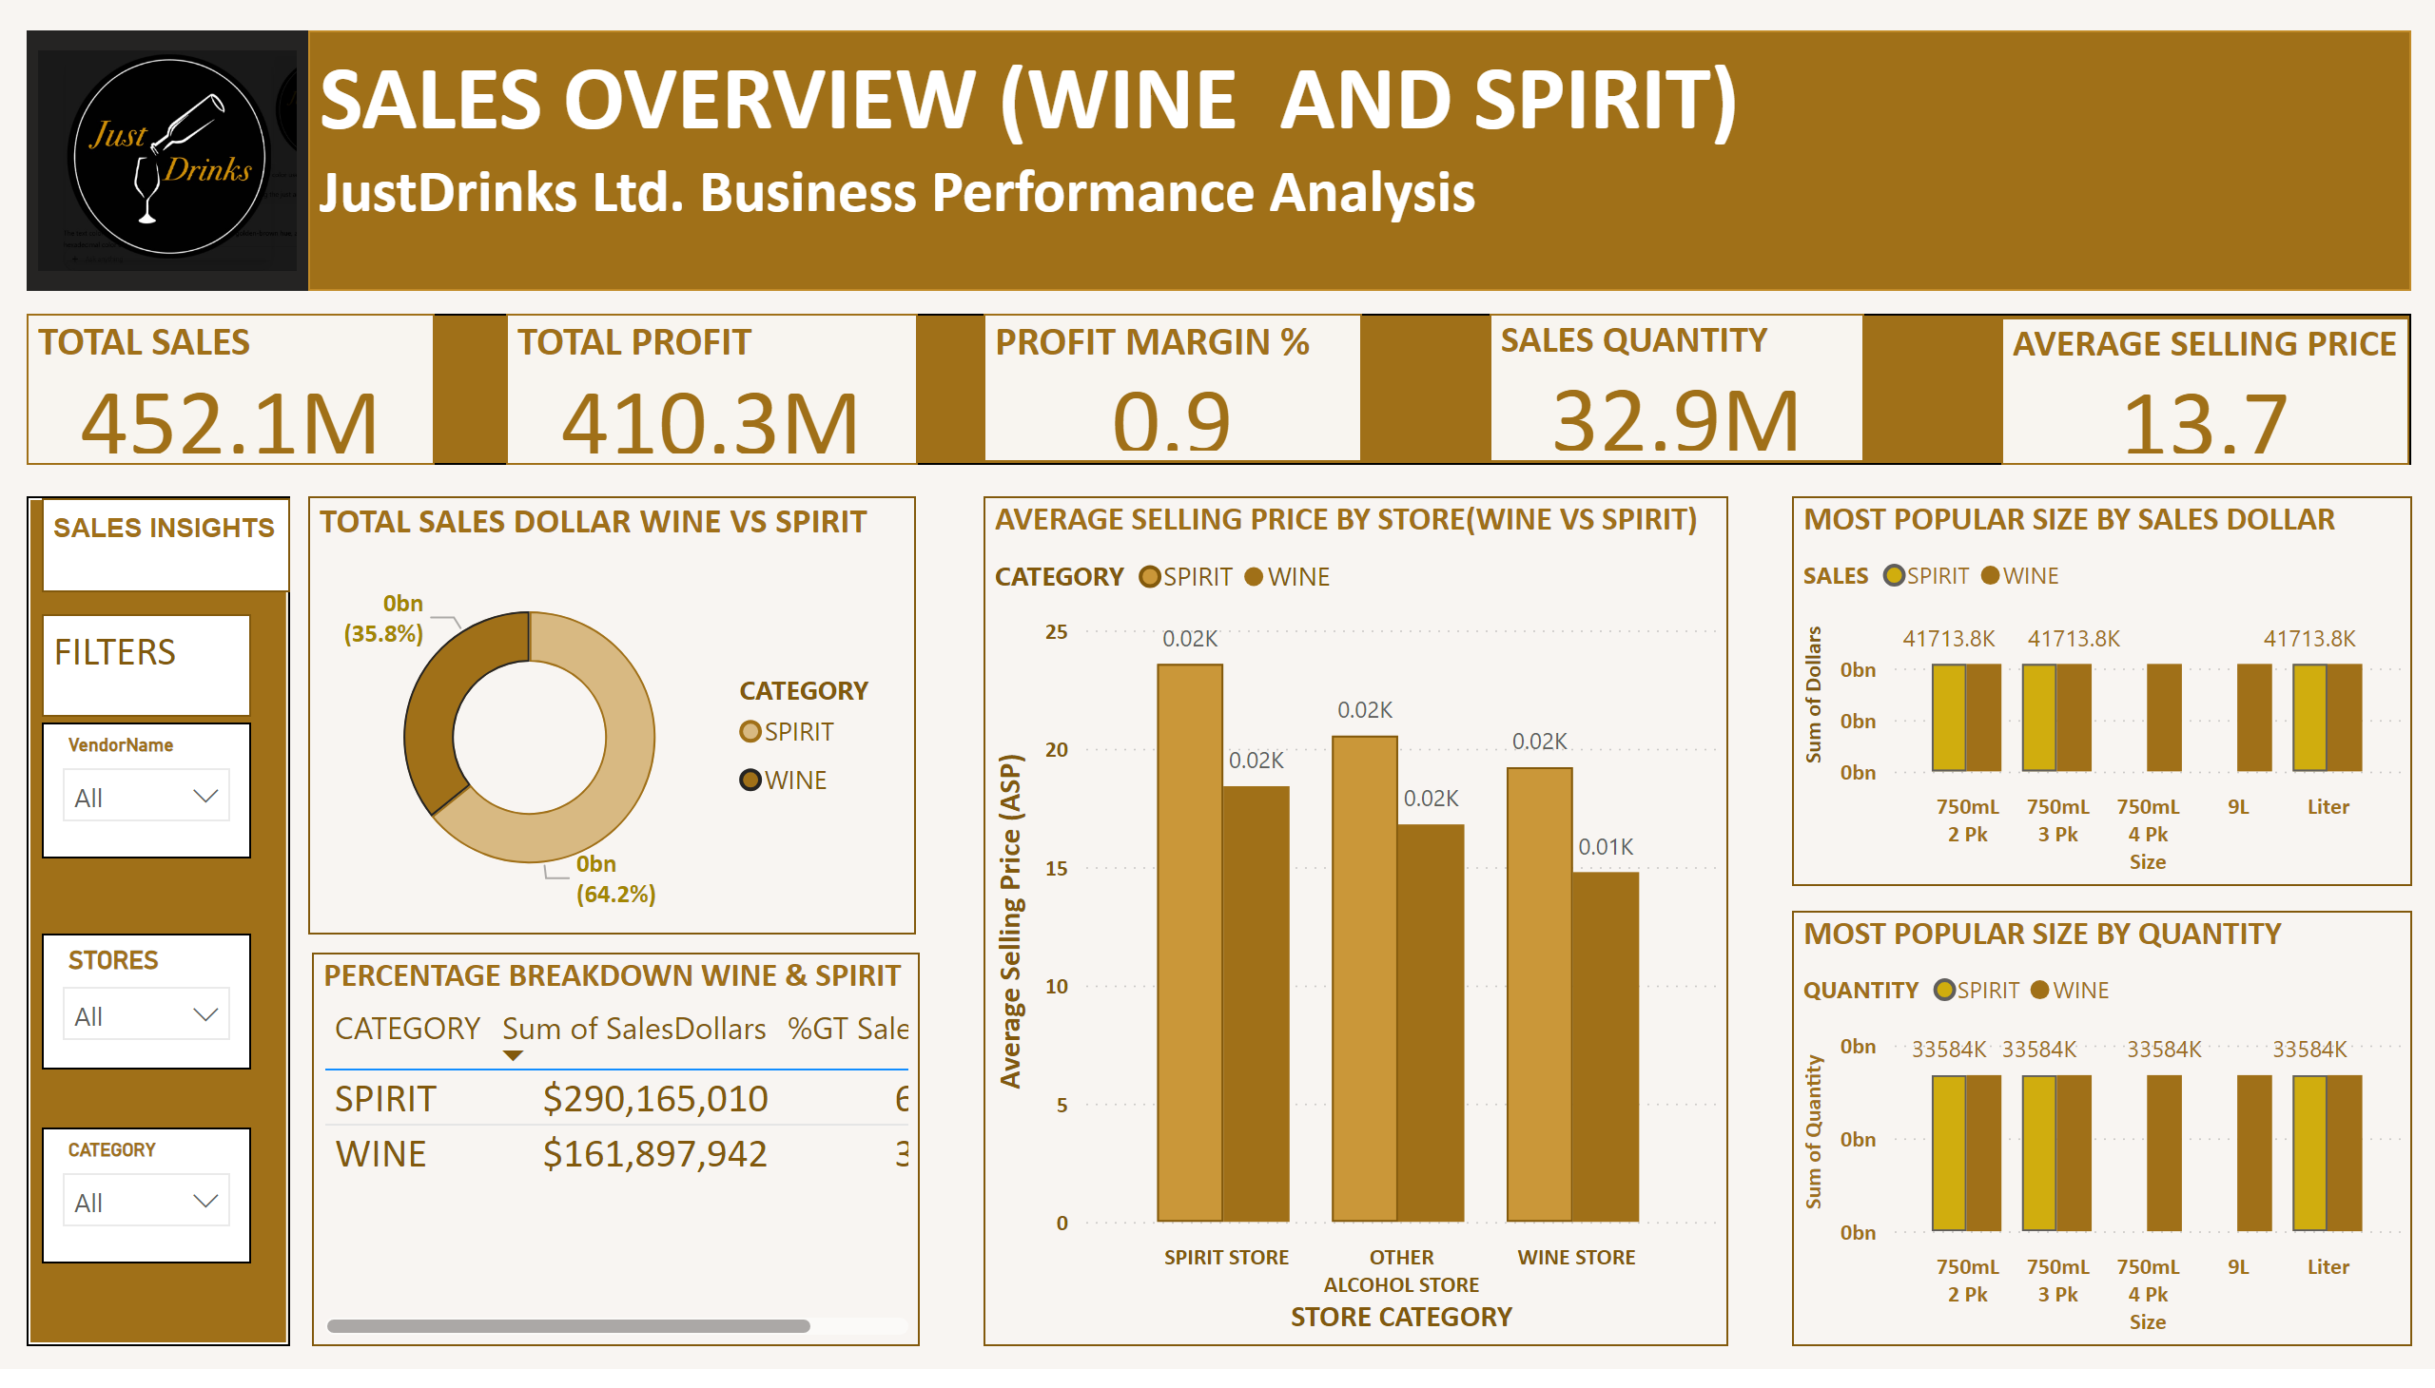
SALES OVERVIEW
Notes:
shape
No alt text provided
slicer
No alt text provided
TOTAL SALES
No alt text provided
AVERAGE SELLING PRICE BY STORE(WINE VS SPIRIT)
No alt text provided
TOTAL SALES DOLLAR WINE VS SPIRIT
No alt text provided
TOTAL PROFIT
No alt text provided
MOST POPULAR SIZE BY QUANTITY
No alt text provided
shape
No alt text provided
slicer
No alt text provided
PROFIT MARGIN %
No alt text provided
textbox
No alt text provided
textbox
No alt text provided
textbox
No alt text provided
PERCENTAGE BREAKDOWN WINE & SPIRIT
No alt text provided
SALES QUANTITY
No alt text provided
image
No alt text provided
shape
No alt text provided
slicer
No alt text provided
MOST POPULAR SIZE BY SALES DOLLAR
No alt text provided
AVERAGE SELLING PRICE
No alt text provided

Slide 6
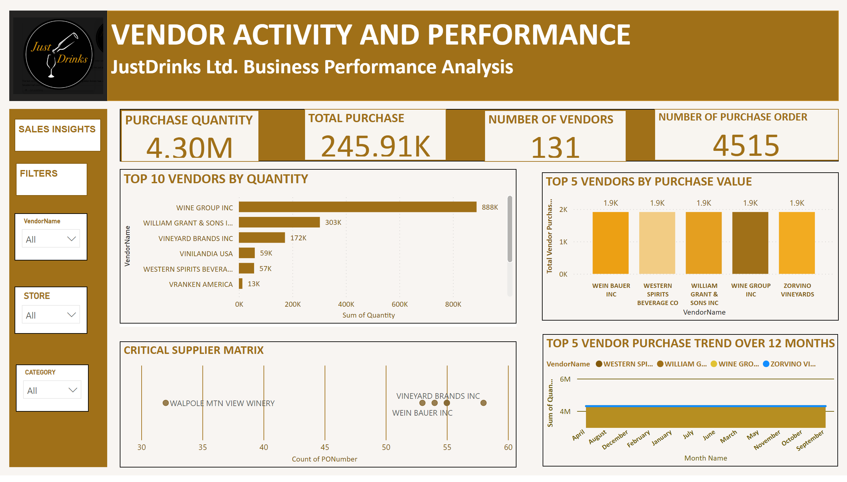
VENDOR ACTIVITY & PERFORMANCE
Notes:
TOP 5 VENDORS BY PURCHASE VALUE
No alt text provided
PURCHASE QUANTITY
No alt text provided
CRITICAL SUPPLIER MATRIX
No alt text provided
slicer
No alt text provided
shape
No alt text provided
textbox
No alt text provided
shape
No alt text provided
NUMBER OF VENDORS
No alt text provided
TOP 5 VENDOR PURCHASE TREND OVER 12 MONTHS
No alt text provided
TOP 10 VENDORS BY QUANTITY
No alt text provided
TOTAL PURCHASE
No alt text provided
slicer
No alt text provided
textbox
No alt text provided
shape
No alt text provided
shape
No alt text provided
shape
No alt text provided
NUMBER OF PURCHASE ORDER
No alt text provided
shape
No alt text provided
textbox
No alt text provided
slicer
No alt text provided
image
No alt text provided
shape
No alt text provided

Slide 7
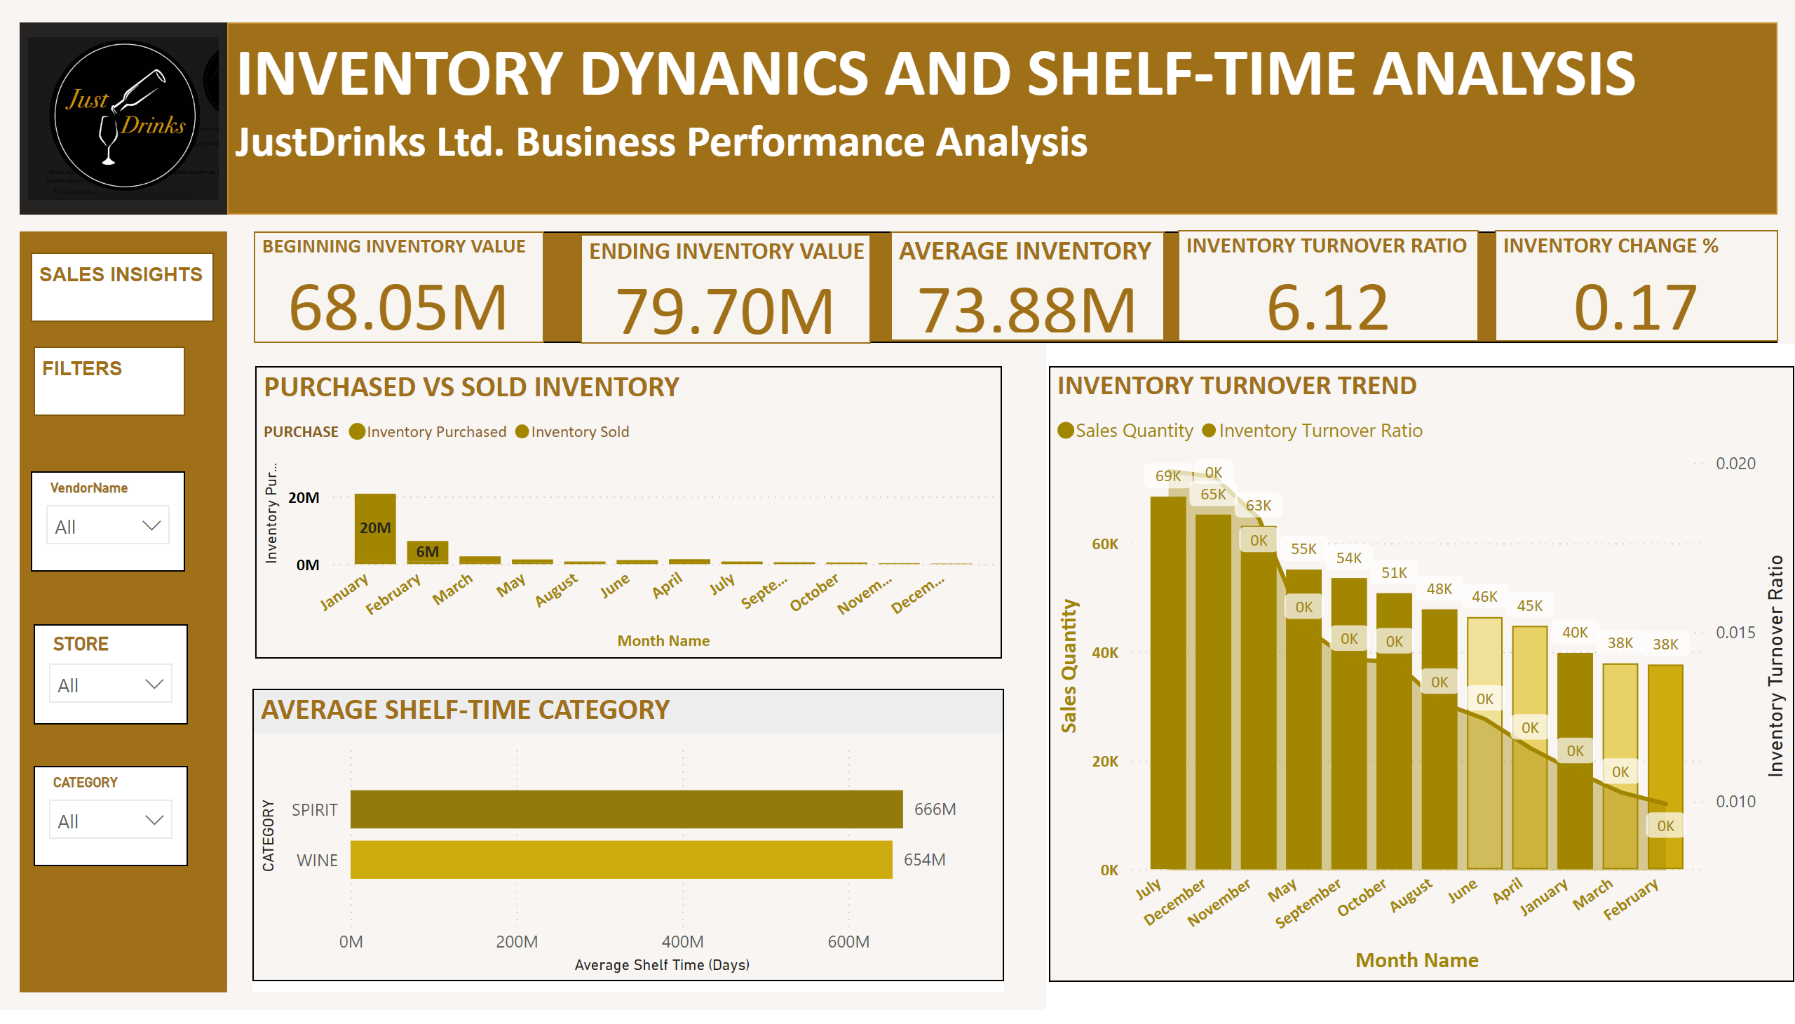
INVENTORY DYNAMICS
Notes:
shape
No alt text provided
shape
No alt text provided
shape
No alt text provided
INVENTORY CHANGE %
No alt text provided
slicer
No alt text provided
slicer
No alt text provided
INVENTORY TURNOVER TREND
No alt text provided
textbox
No alt text provided
slicer
No alt text provided
image
No alt text provided
ENDING INVENTORY VALUE
No alt text provided
PURCHASED VS SOLD INVENTORY
No alt text provided
AVERAGE SHELF-TIME CATEGORY
No alt text provided
shape
No alt text provided
shape
No alt text provided
textbox
No alt text provided
textbox
No alt text provided
shape
No alt text provided
AVERAGE INVENTORY
No alt text provided
BEGINNING INVENTORY VALUE
No alt text provided
INVENTORY TURNOVER RATIO
No alt text provided

Slide 8
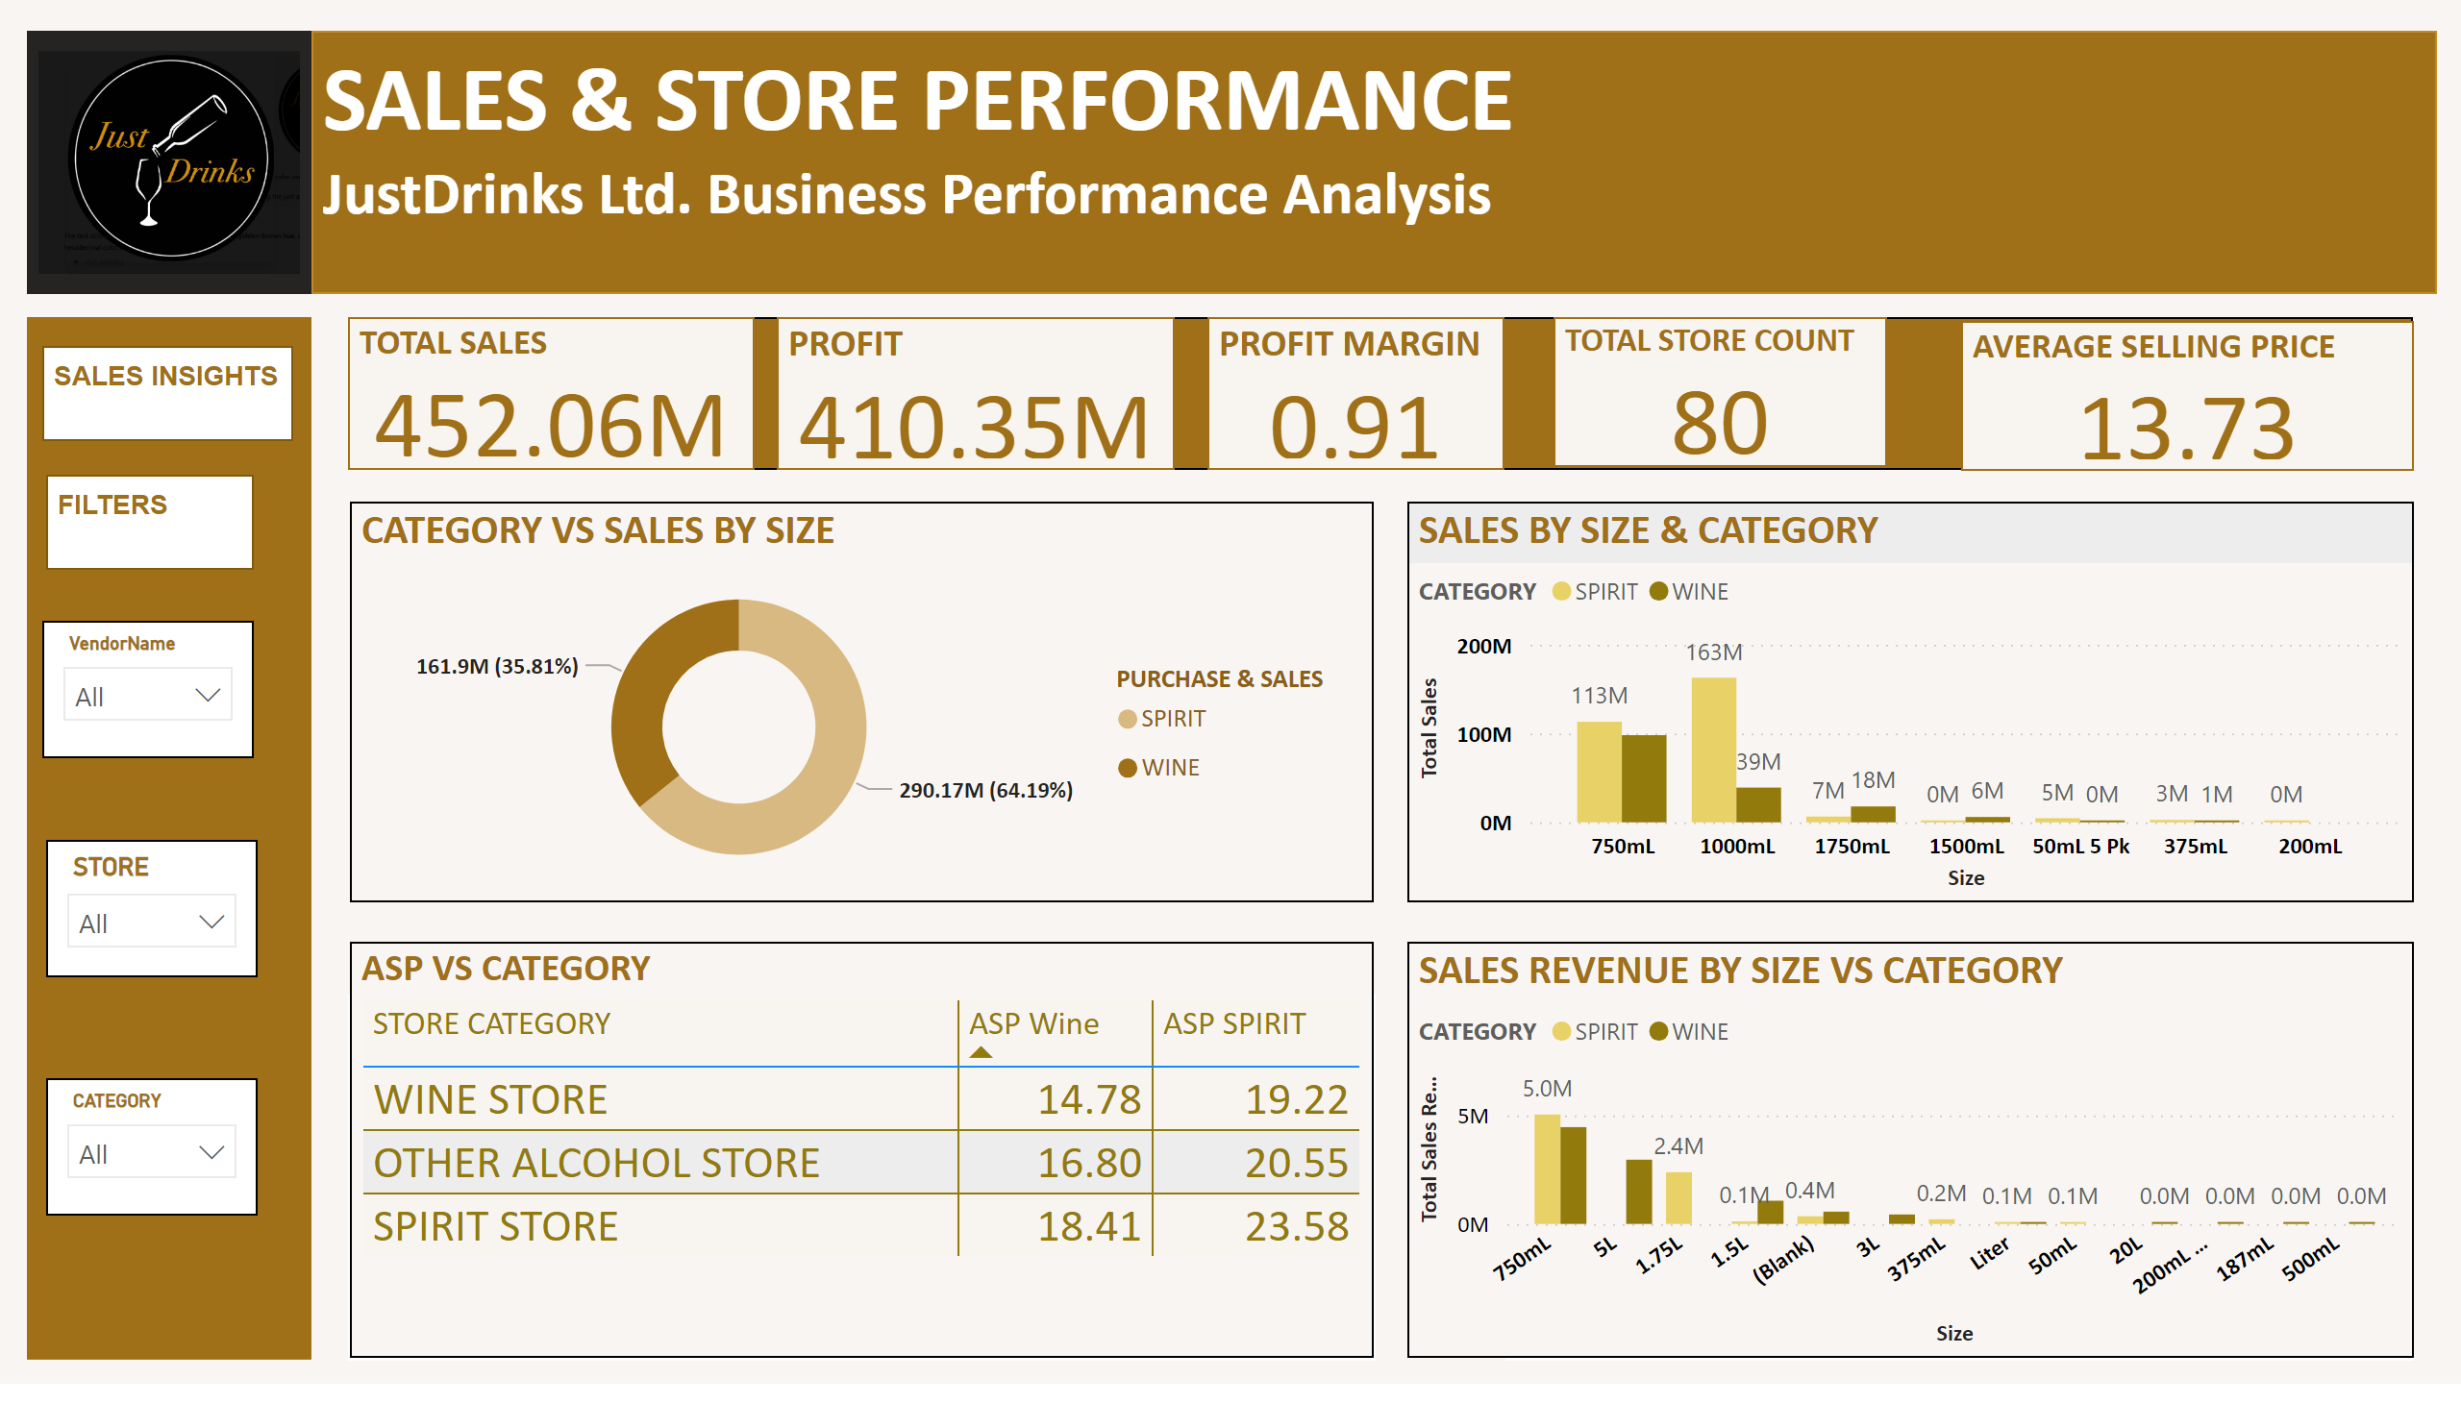
SALES PERFORMANCE
Notes:
shape
No alt text provided
shape
No alt text provided
ASP VS CATEGORY
No alt text provided
shape
No alt text provided
AVERAGE SELLING PRICE
No alt text provided
shape
No alt text provided
slicer
No alt text provided
CATEGORY VS SALES BY SIZE
No alt text provided
SALES REVENUE BY SIZE VS CATEGORY
No alt text provided
textbox
No alt text provided
TOTAL STORE COUNT
No alt text provided
shape
No alt text provided
shape
No alt text provided
PROFIT
No alt text provided
SALES BY SIZE & CATEGORY
No alt text provided
textbox
No alt text provided
textbox
No alt text provided
slicer
No alt text provided
TOTAL SALES
No alt text provided
shape
No alt text provided
PROFIT MARGIN
No alt text provided
image
No alt text provided
slicer
No alt text provided

Slide 9
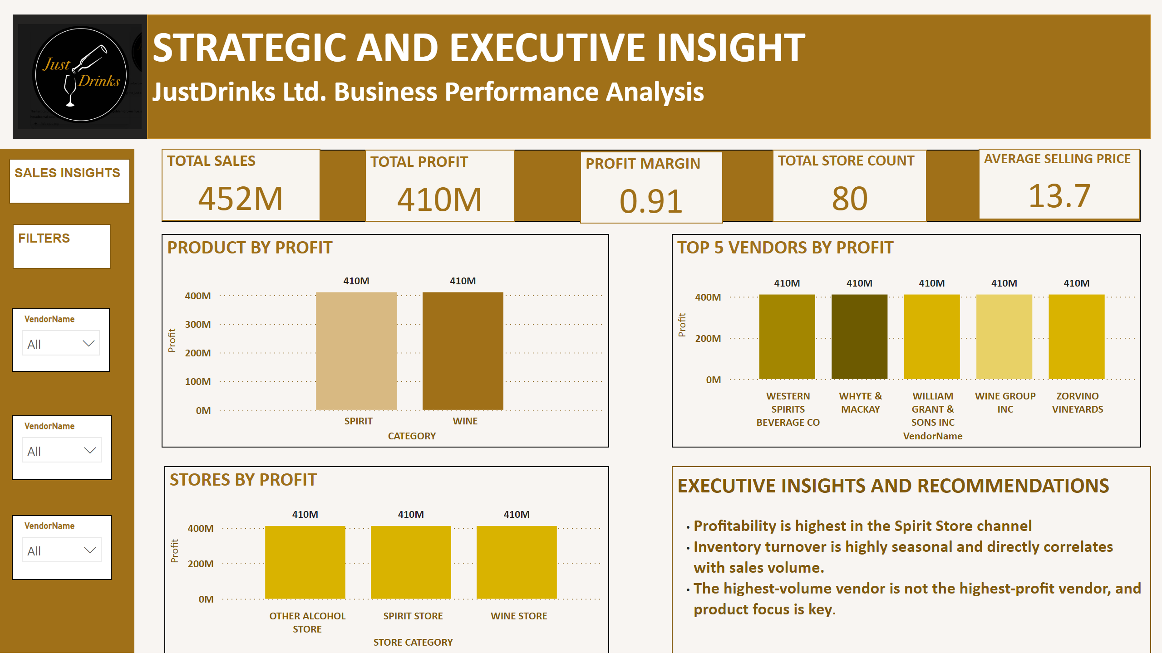
STRATEGIC & EXECUTIVE INSIGHT
Notes:
shape
No alt text provided
TOTAL SALES
No alt text provided
slicer
No alt text provided
shape
No alt text provided
slicer
No alt text provided
TOP 5 VENDORS BY PROFIT
No alt text provided
TOTAL PROFIT
No alt text provided
shape
No alt text provided
PRODUCT BY PROFIT
No alt text provided
textbox
No alt text provided
PROFIT MARGIN
No alt text provided
image
No alt text provided
STORES BY PROFIT
No alt text provided
textbox
No alt text provided
textbox
No alt text provided
textbox
No alt text provided
TOTAL STORE COUNT
No alt text provided
AVERAGE SELLING PRICE
No alt text provided
slicer
No alt text provided

Slide 10
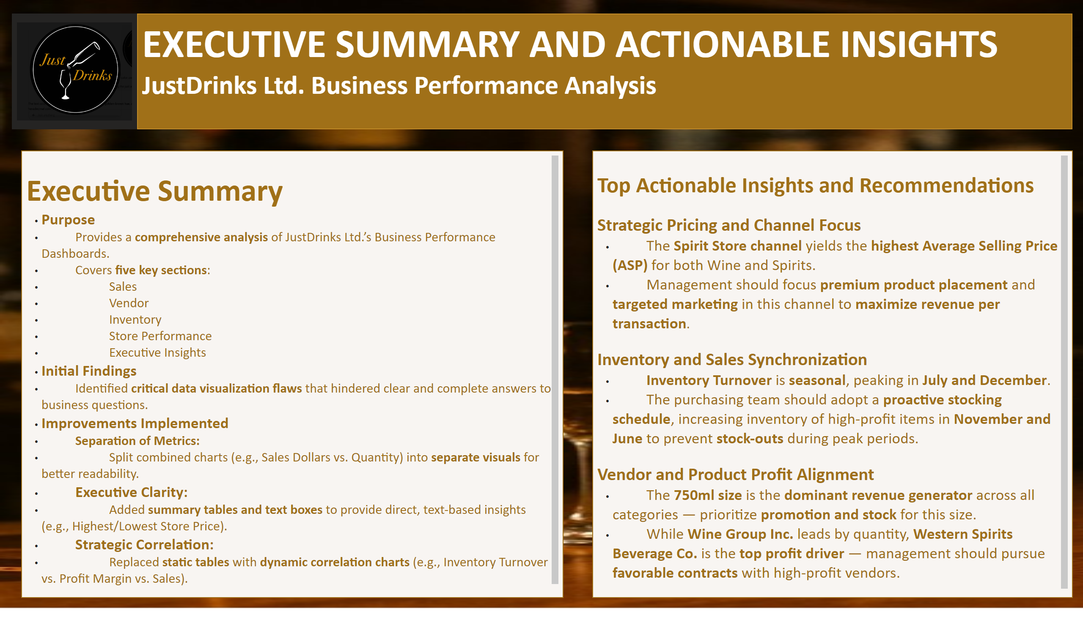
EXECUTIVE SUMMARY
Notes:
image
No alt text provided
textbox
No alt text provided
textbox
No alt text provided
textbox
No alt text provided

Slide 11
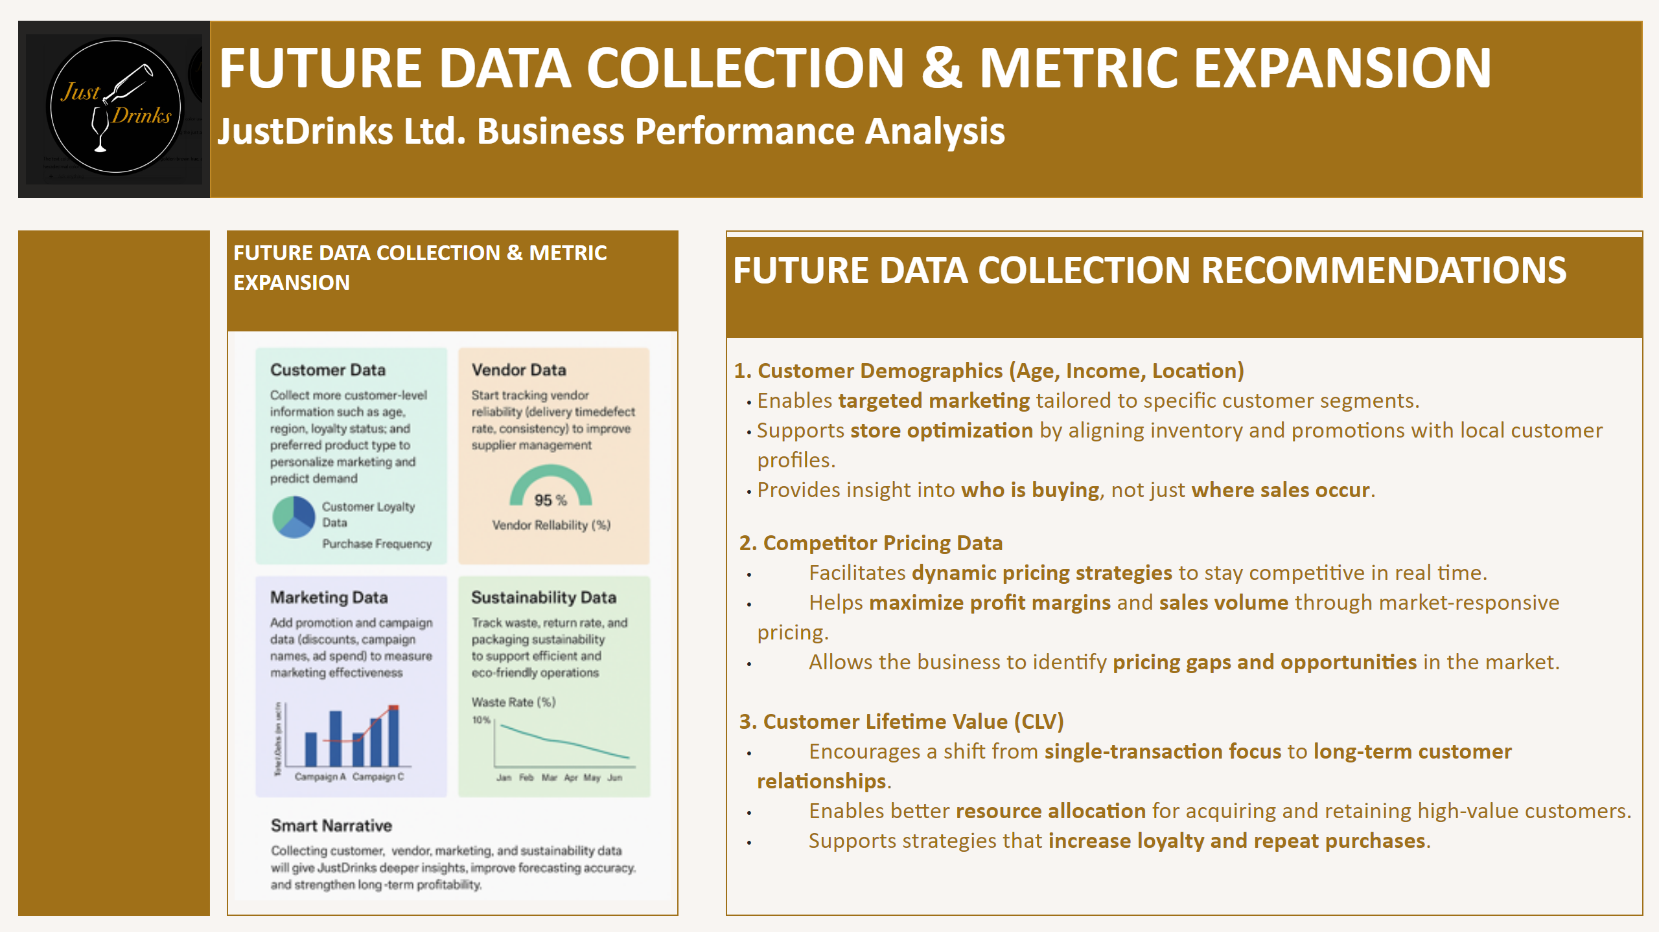
FUTURE DATA COLLECTION
Notes:
textbox
No alt text provided
textbox
No alt text provided
textbox
No alt text provided
textbox
No alt text provided
image
No alt text provided
shape
No alt text provided
image
No alt text provided

Slide 12
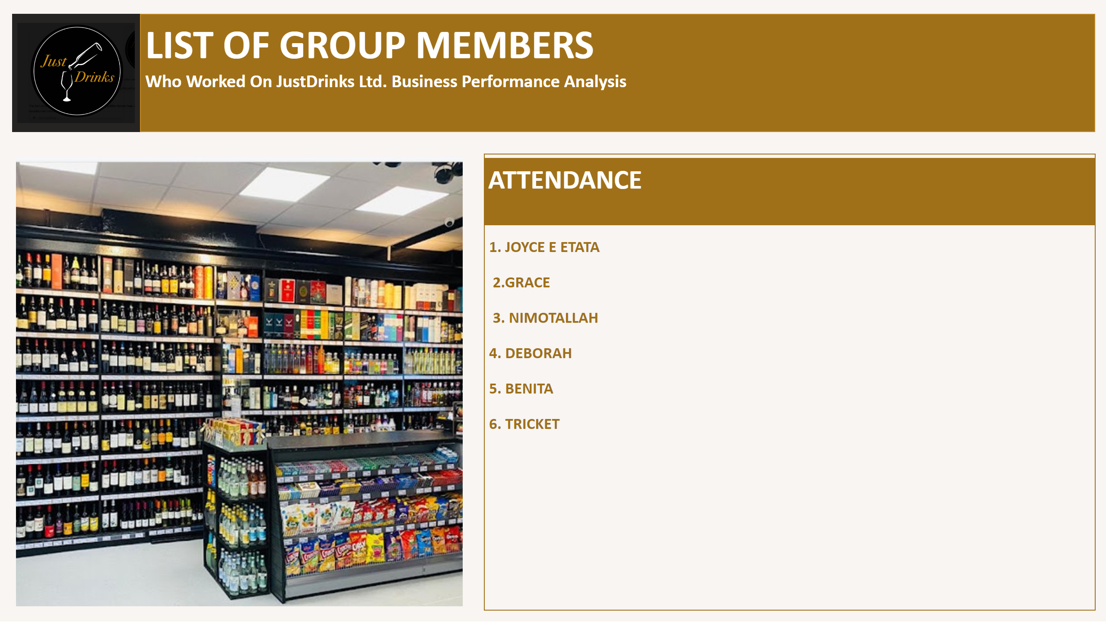
ATTENDANCE
Notes:
image
No alt text provided
textbox
No alt text provided
image
No alt text provided
textbox
No alt text provided
textbox
No alt text provided

